Slide 1

Bivariate analysis: Contingency tables
Investigation & Report

Slide 2
Bivariate Analysis
Simultaneous analysis of two variables (attributes)
Examining the relationship between two variables (association)
If two variables are associated, we can predict the score of a case on one variable from the score of that case on the other variable
E.g. If education and salary are associated, we can predict that people who have college degree will have higher salary than those who have only high school diploma
Dependent and independent variables
Strength of the relationship
Direction or pattern of the relationship
Statistical significance test → Are the relationships observed in the sample caused by pure random chance? Can we detect nonrandom relationships?

Slide 3
Dependent vs. Independent Variables
Three most typical pairs
Independent categorical & Dependent categorical
Level of education vs SES (high, middle, and low)
Independent categorical & Dependent continuous (ratio)
Level of education vs income (annual $)
Independent continuous (ratio) & Dependent continuous (ratio)
Age (years) & income (annual $)

Slide 4
Bivariate Analysis
Contingency tables (Crosstabs) → Relationship between two categorical variables
Comparing means → Relationship between a categorical independent and a continous dependet variable
Compare means of a continuous variable across different groups
Independent Variable
Nominal
Ordinal
Dependent Variable
Nominal
Ordinal
Independent Variable
Nominal
Ordinal
Dependent Variable
Interval
Ratio
5-scale ordinal-level allowed

Slide 5
Bivariate Analysis
Simple Regression → Relationship between two interval/ratio level variables
Independent Variable
Interval
Ratio
Dependent Variable
Interval
Ratio
5-scale ordinal-level allowed

Slide 6
Bivariate Analysis of Categorical Variables
We display the scores of two different variables at the same time in table (matrix) format
Commonly used technique in research
Different names of the same technique:
Contingency tables
Bivariate tables
Crosstabs

Slide 7
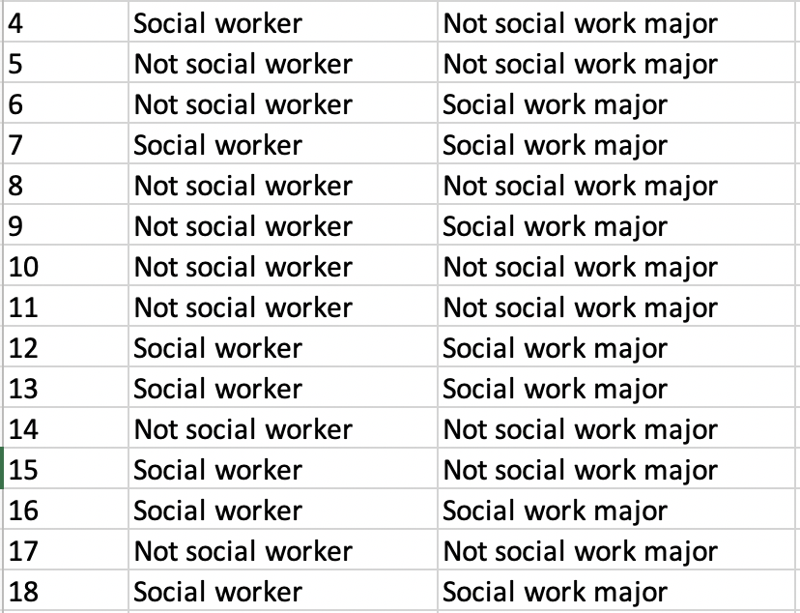
Raw data

Slide 8
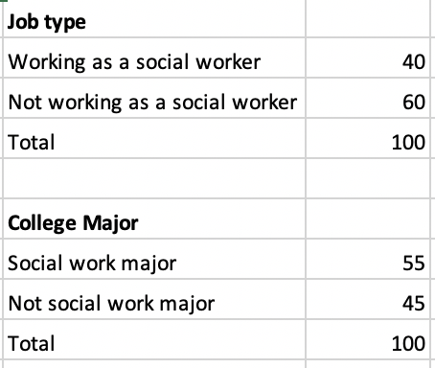
Frequency Distribution

Slide 9
Contingency Table
Dependent variable as the row
Put the independent variable as the column
 | College Major
Job type | Social work major | Not social work major | Total
Working as a social worker | 30 | 10 | 40
Not working as a social worker | 25 | 35 | 60
Total | 55 | 45 | 100
Row marginals
Column marginals
Raw numbers don’t tell us too much: They need to be standardized
We calculate column percentages

Slide 10
Interpreting Contingency Tables
 | College Major
Job type | Social work major | Not social work major | Total
Working as a social worker | 30 (55%) | 10 (22%) | 40 (40%)
Not working as a social worker | 25 (45%) | 35 (78%) | 60 (60%)
Total | 55 (100%) | 45 (100%) | 100 (100%)
Make a comparison across independent variable: We want to compare people with different majors
Students with social work major will more likely to work as a social worker
55% of social work majors are working as a social worker while only 22% of not social work majors are working as a social worker

Slide 11
Interpreting Contingency Tables
Opinion on death penalty | Political ideology |  |  | Total
 | Liberal | Moderate | Conservative
Favor | 55.4% | 70.1% | 75.1% | 462 (68.1%)
Oppose | 44.6% | 29.9% | 24.9% | 216 (31.9%)
Total | 100% | 100% | 100% | 678 (100%)
Make a comparison across independent variable: We want to compare people with different political ideology
44.6% of liberals oppose death penalty while 29.9% of moderates and only 24.9% of conservatives oppose death penalty
In the whole sample 31.9% of respondents opposed death penalty: Liberals are overrepresented among those opposing death penalty

